Slide 1

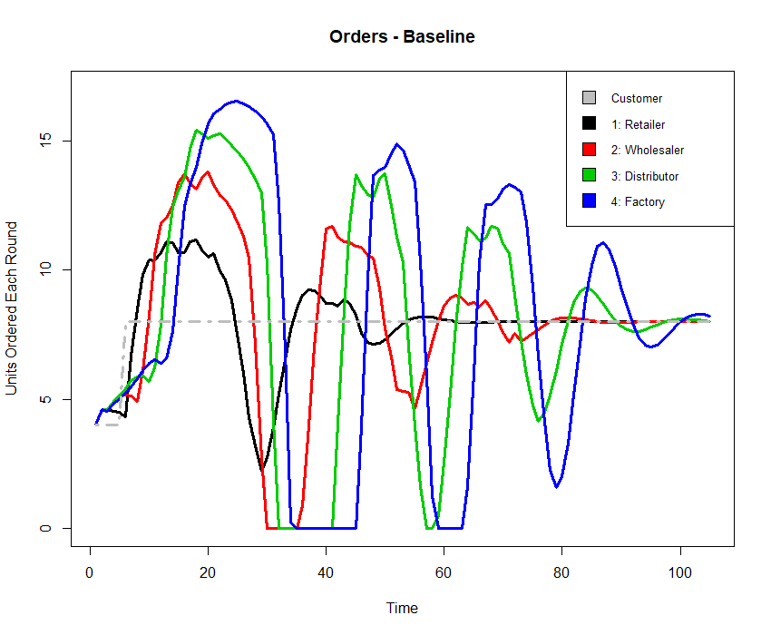
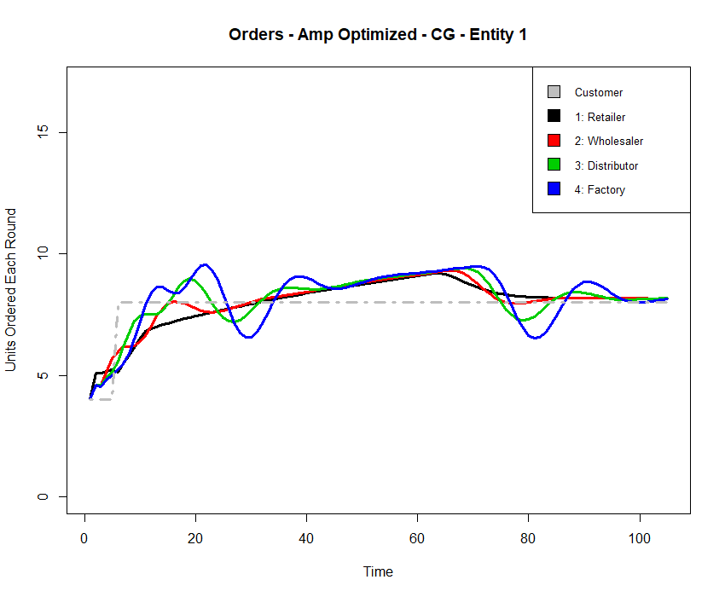
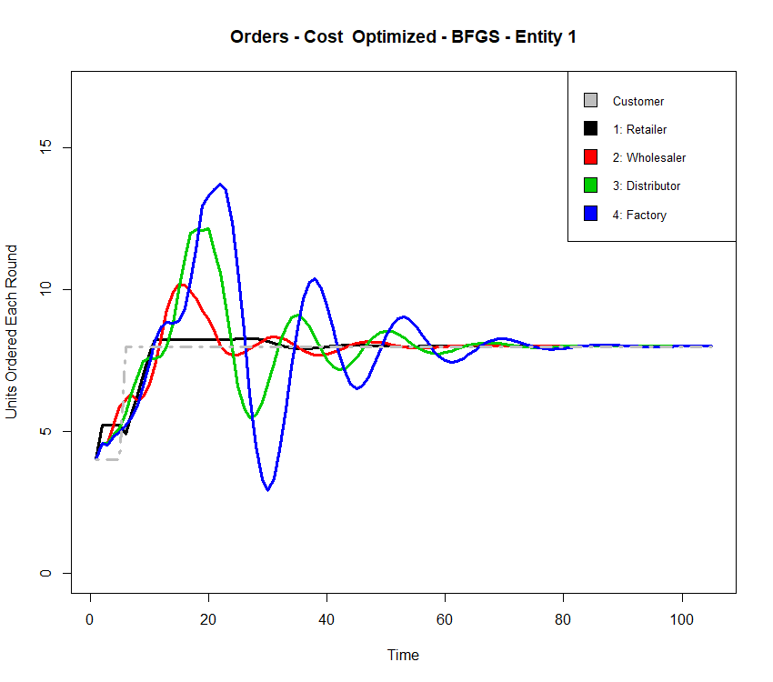
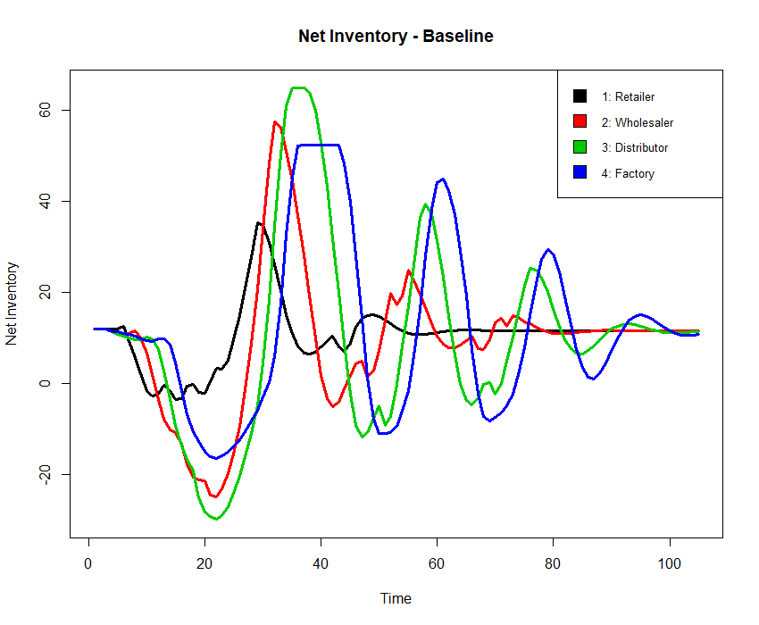
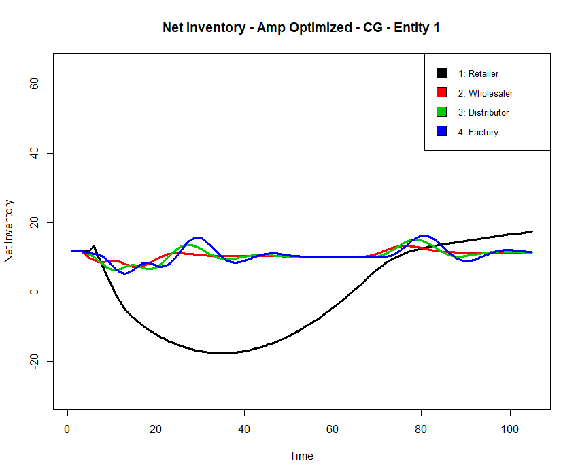
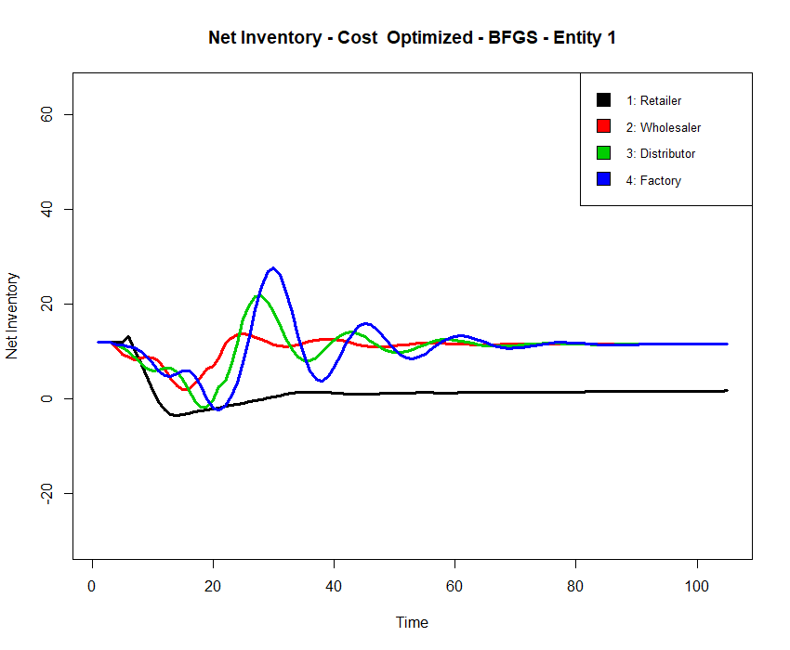
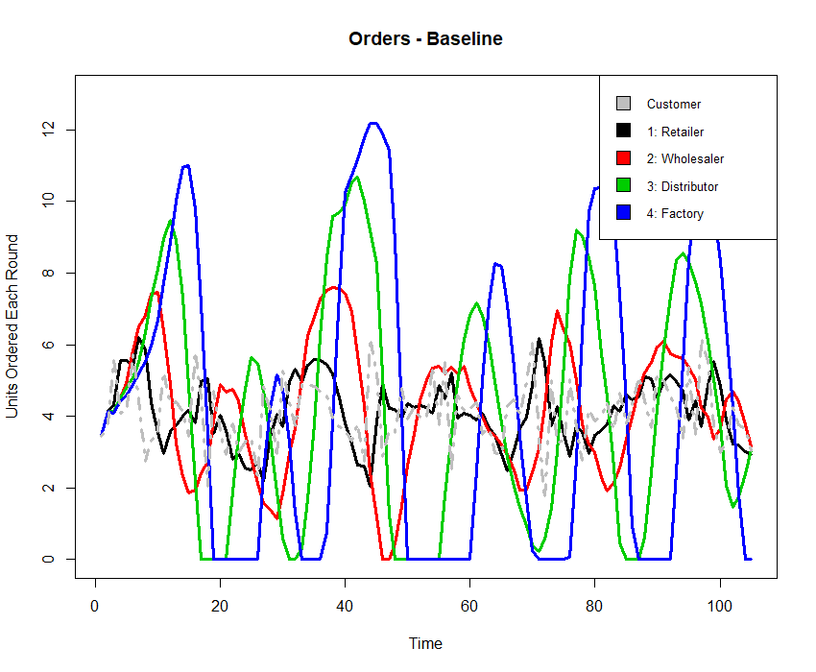
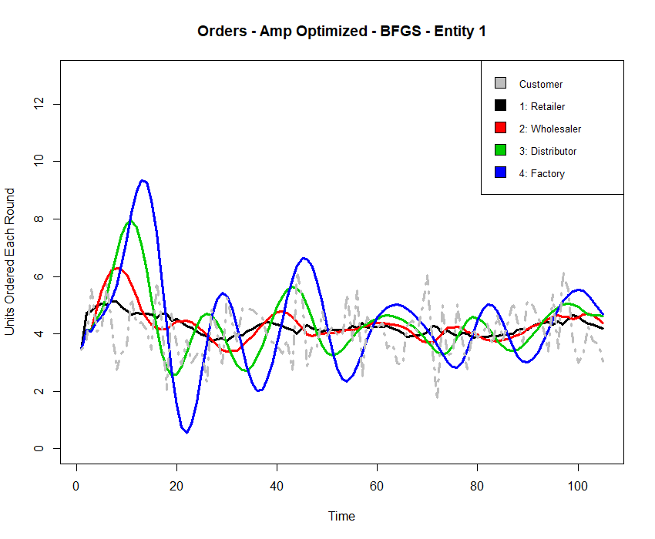
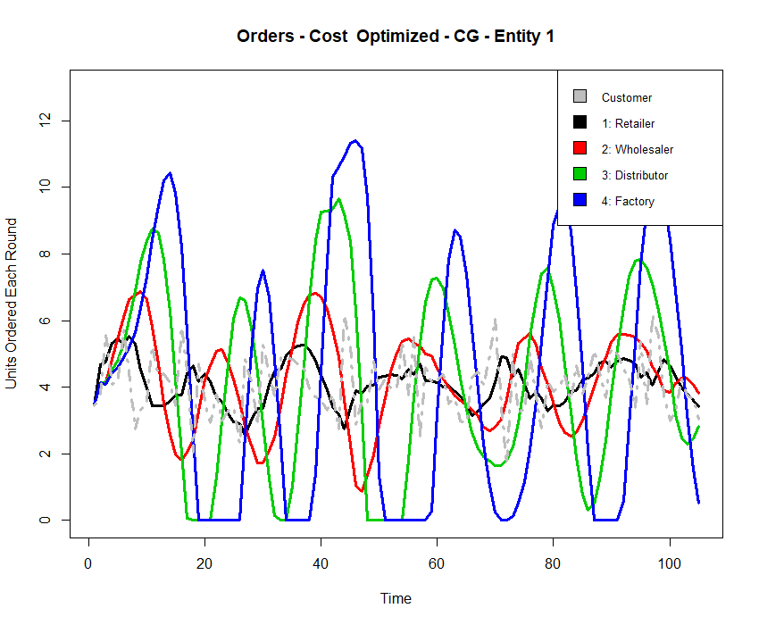

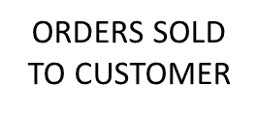
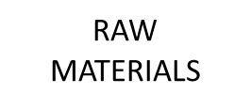






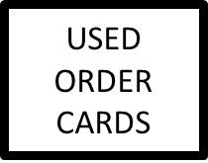
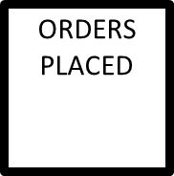

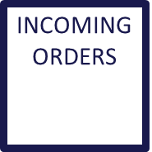

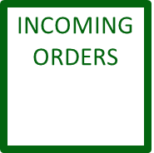

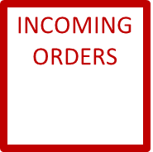


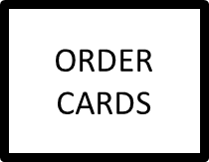

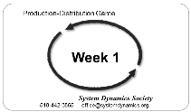
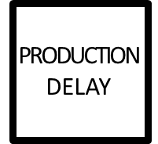
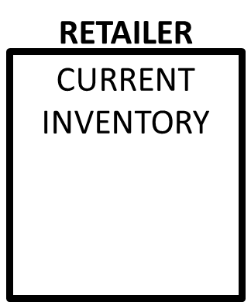

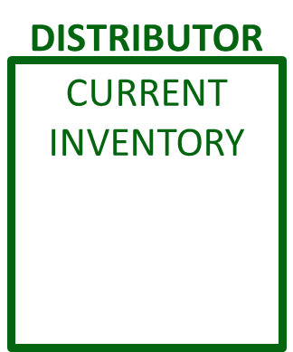
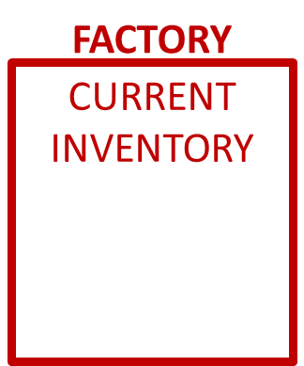

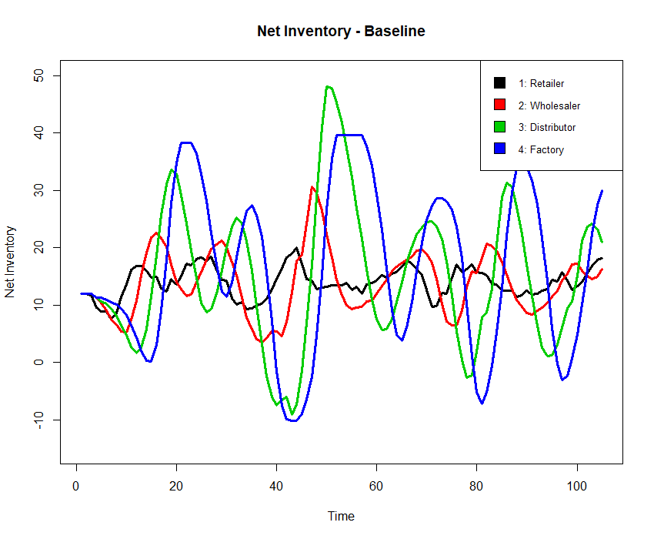
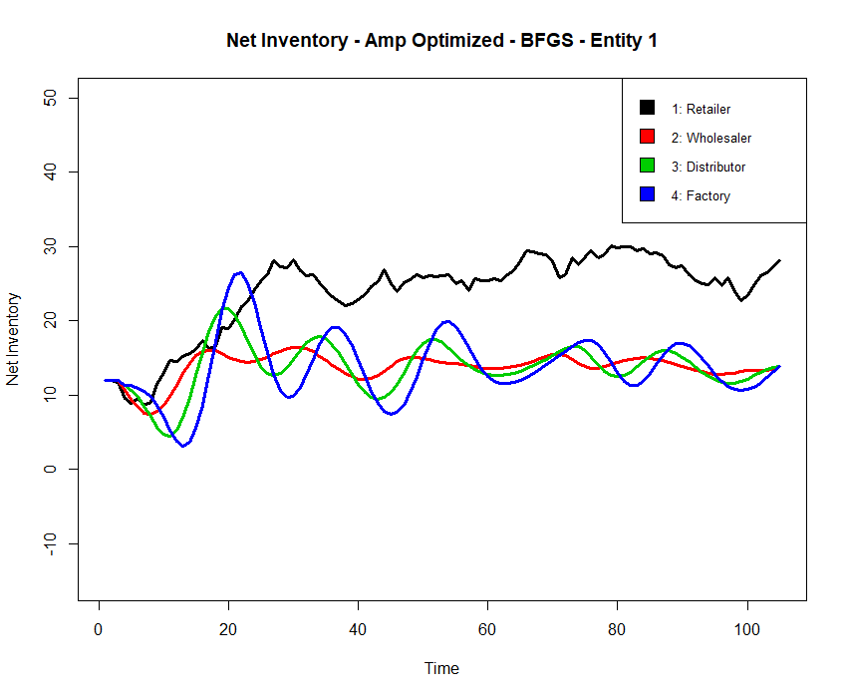
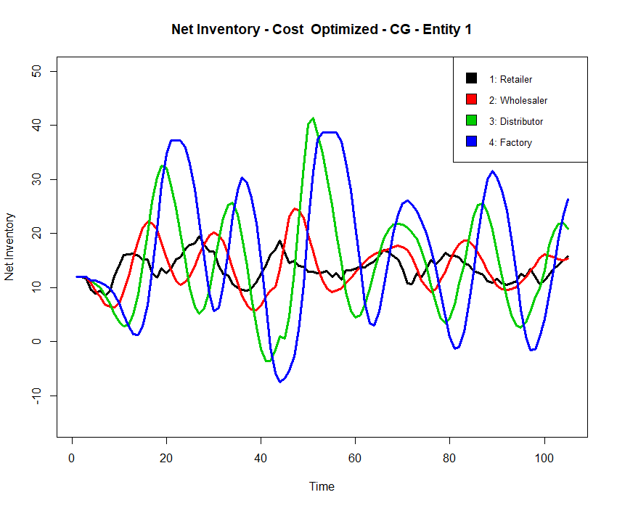
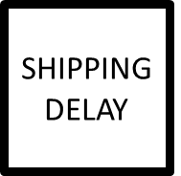
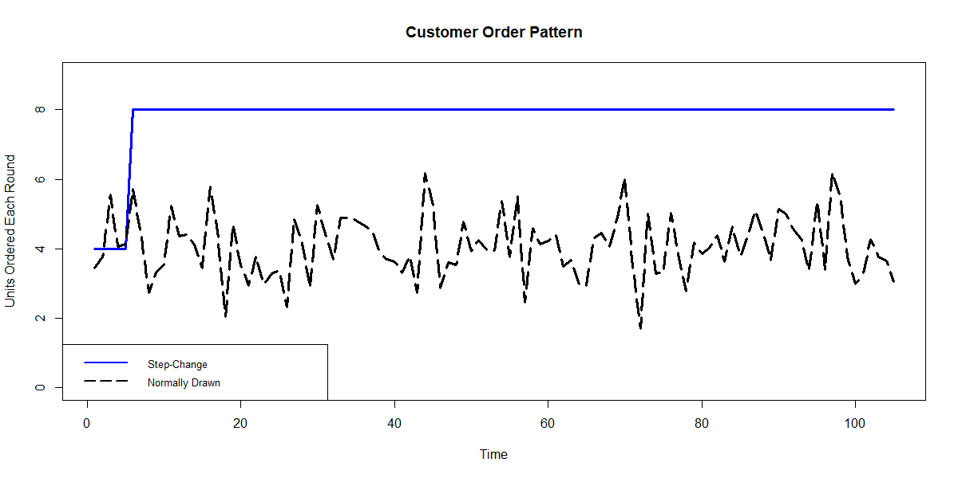

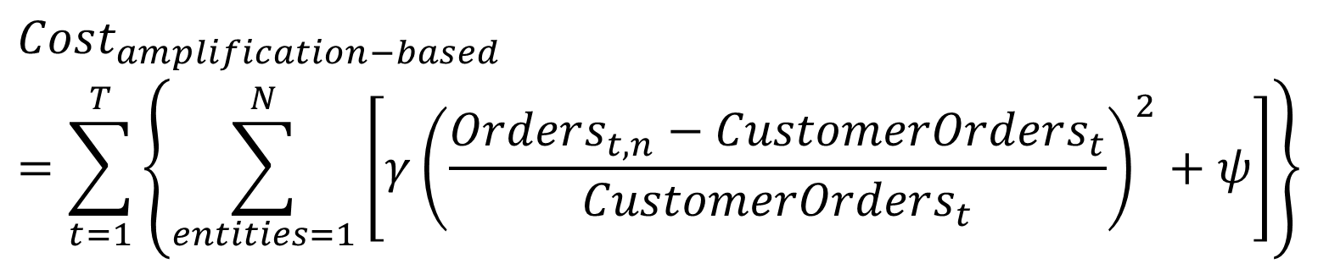
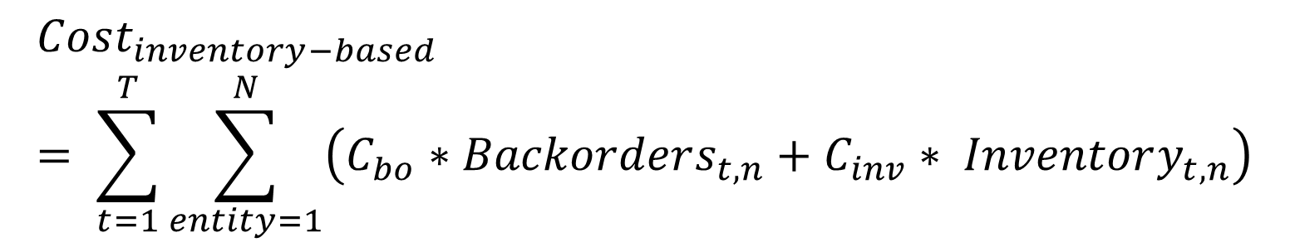
Taming the Bull Mitigation of Inventory and Ordering Amplification in Multi-Echelon Supply Chains
James E. Paine MIT Sloan School of Management – System Dynamics Group
BACKGROUND
MODELING HUMAN BEHAVIOR
SELECTED RESULTS
Bullwhip Effect is the increasing amplitudes in both orders and on-hand inventory positions the further one moves away from a source of order variability
This is a persistently observable phenomena in supply chains
Project Goal: develop an algorithm capable of mitigating bullwhip that is:
Useful
Implementable
Understandable
Human Behavior Modeled from historic data
Parameters roughly translate as
Θ ≈ smoothing of the expected inventory loss next round
α ≈ influence of net on hand stock less inbound supply line
β ≈ influence of inbound supply line
S’ ≈ Next inventory position
BASELINE (Human Modeled Players)
EXAMPLE OPTIMZATIONS (Humans + Algorithm)
$$O_{t}=MAX\left(0,\hat{L_{t}}+α_{S}\left(S^{′}−S_{t}−β SL_{t}\right)+ε_{t}\right)$$
$$where \hat{L_{t}}= θL_{t−1}+\left(1−θ\right){\hat{L}}_{t−1}$$
Step Change in Orders
Modeling Framework: The Beer Game
The Beer Game is a classical inventory management and System Dynamics simulation and learning tool
Multi-agent decentralized supply chain is modeled, much like real decentralized inventory management systems
Nearly 50 years of history (and data) at MIT as use as a business simulator and teaching tool
OPTIMIZING THE AGENT
Directly optimized the four parameters in the fitted human model
Optimized across each of the four positions, with remaining three using average parameters fitted to historic Beer Game runs
Explored optimization using three different methods
Optimized across two different cost functions
Optimized against step-increase in customer demand
Tested against both step-change and normally drawn demands
$$Cost_{inventory−based}= \sum_{t=1}^{T}{\sum_{entity=1}^{N}{\left(C_{bo}∗Backorders_{t,n}+C_{inv}∗ Inventory_{t,n}\right)}}$$
Normally Drawn Orders
$$Cost_{amplification−based}=\sum_{t=1}^{T}{\left\{\sum_{entities=1}^{N}{\left[{γ\left(\frac{Orders_{t,n}−CustomerOrders_{t}}{CustomerOrders_{t}}\right)}^{2}+ψ\right]}\right\}}$$
MODELING METHODOLOGY
Simulatable and functional form of the Beer Game created
Self-contained simulation of the system over a given time horizon
Callable function that takes a given state-action pair and returns an updated state
Created dynamic environment to train a model based on actual performance and feedback in the Beer Game
CONCLUSIONS
It is possible to construct an optimized agent that mitigates bullwhip
Use of existing human-based decision modeling allows for optimization to be understandable
Optimized agents at the extrema of the supply chain act as base-stock level seeking agents (low θ and β)
Optimized agents in the middle of the supply chain act as risk-adverse inventory buffers (high S’ and β)
Next steps: empirical study of bullwhip mitigation using optimized agent with real players and development of Policy Gradient-based agent
Visit
github.mit.edu/jpaine/Taming-the-Bull
…for documented simulation code, full report write-up, citations, and to keep up with project progress!

